Slide 1
Playtesting: Hikari no To
Computer Games Laboratory 2017/2018
Team Pick One:
Muhammad Inshal Uddin
Paul Preißner
Jonas Mayer
Artem Bishev
Freddy Faulig
Technical University of Munich
24.01.2018

Slide 2
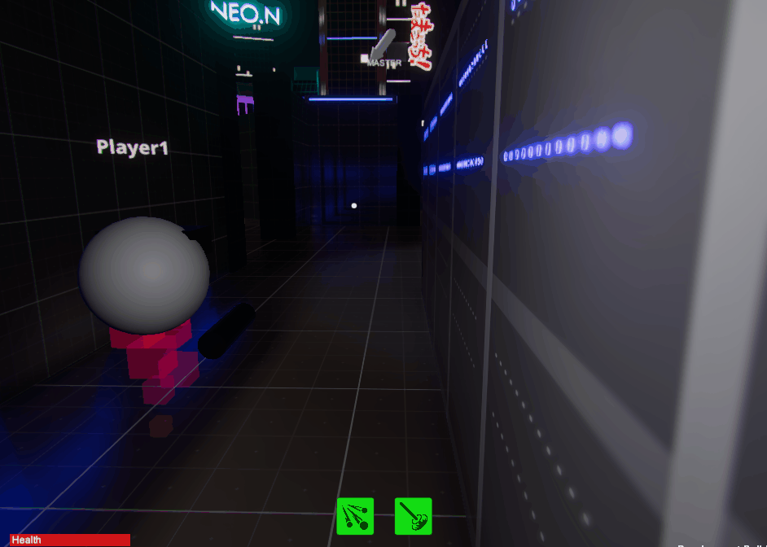
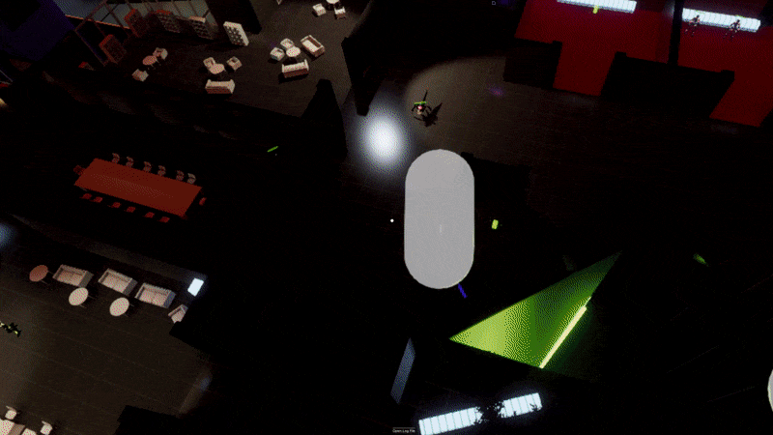
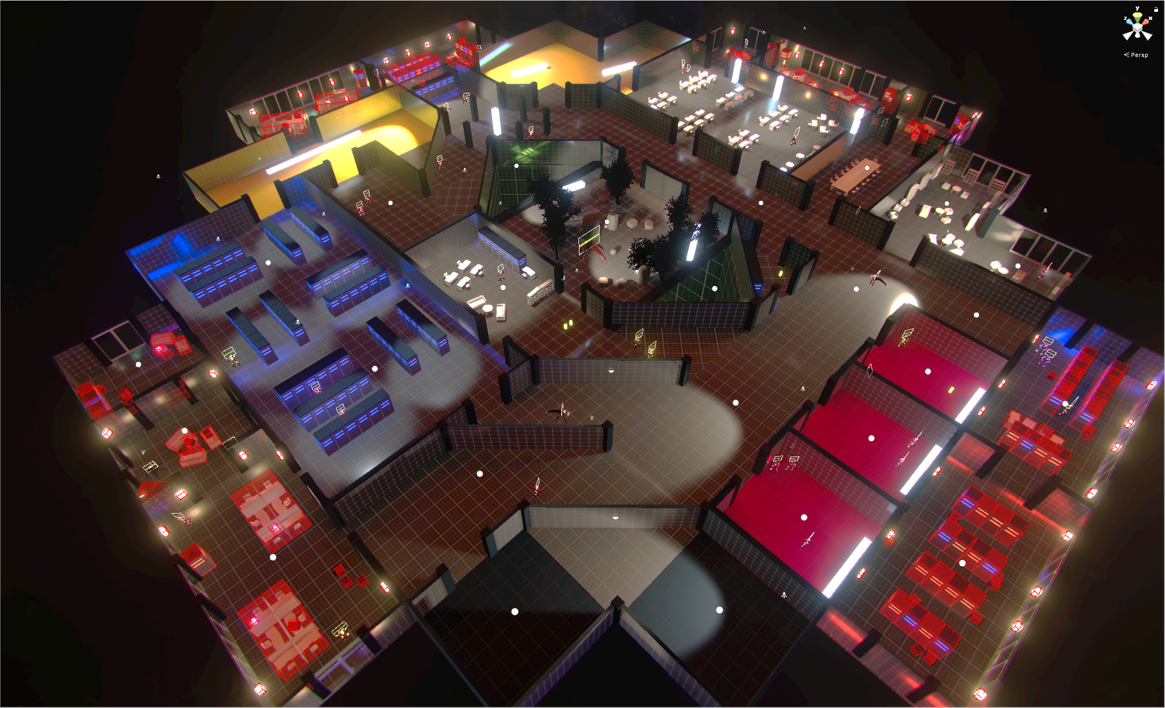
Before playtesting
New features:
Master Teleportation
Resources for Master abilities
Increased Map
Collectibles
And so much more!

Slide 3
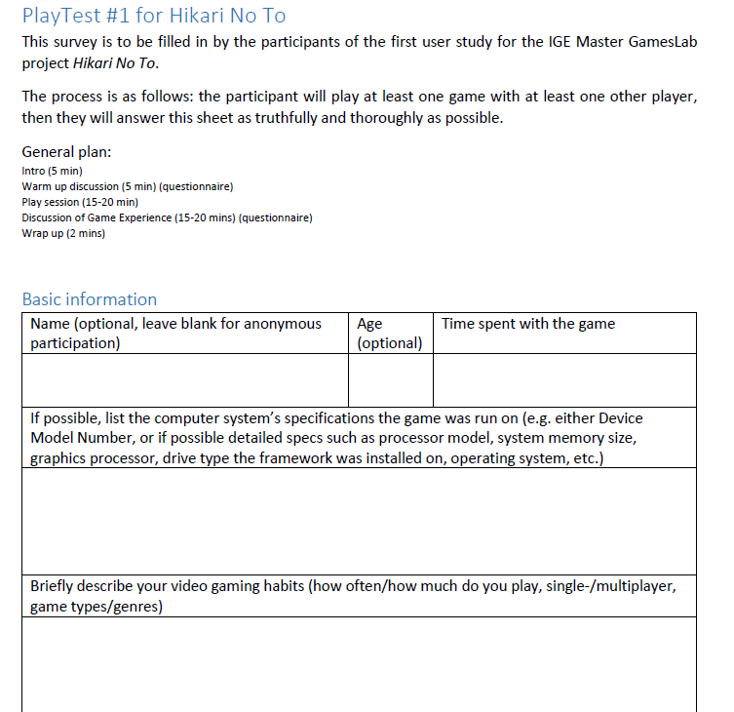
Playtest: Overview
Online Multiplayer: 4 Crawlers + 1 VR Master
Test Crawlers and Master separately:
Two Tests for Crawlers
One Test for the Master
Let participants fill out a standardized questionnaire

Slide 4
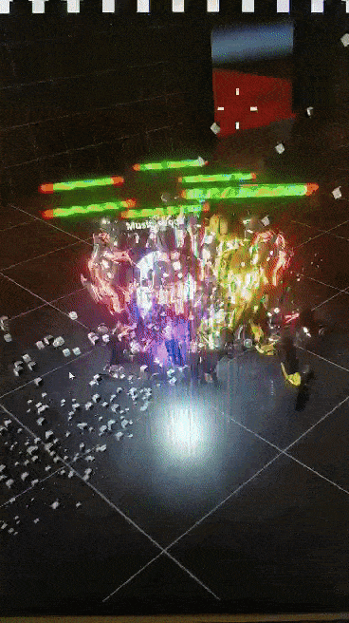
Playtest: Pilot
Idea: to find the biggest flaws, one tester should be enough
Setup: 1 Tester + 2 Team Members in Teamspeak
One hour of intense testing

Slide 5
Playtest: Pilot
Feedback includes:
Music horrible -> No sound slider
Effects too bright
Camera weird
Class Balancing
Bugs
More Bugs
Mooaaaar Bugs
Most short-comings resolved later
YOUR GAME SUCKS!

Slide 6
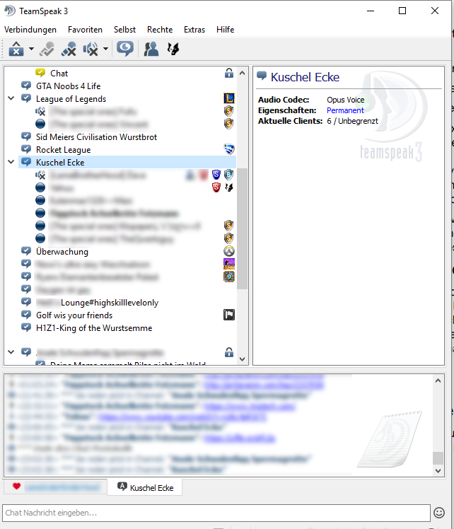
Playtest: Large-Scale
Crawler testers only
7 testers + 2 team members
Distribute build in TeamSpeak server filled with colleagues and watch the madness unfold
Full matches, no prior instructions
Plenty of unfiltered feedback

Slide 7
Playtest: Large-Scale
Feedback included (solved, partially solved, unsolved):
Technical issues (events not triggering, disconnects, update rate/smoothing)
Interface issues (UI scaling, lack of indicators)
Gameplay issues (class imbalance, master awareness, unsatisfying enemy search, boring after death)
Miscellaneous issues (main menu glitchy, bad sound mix, janky camera)
and more…

Slide 8
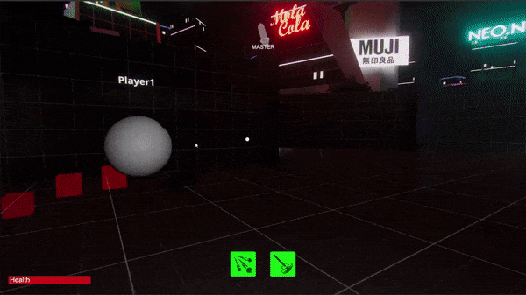
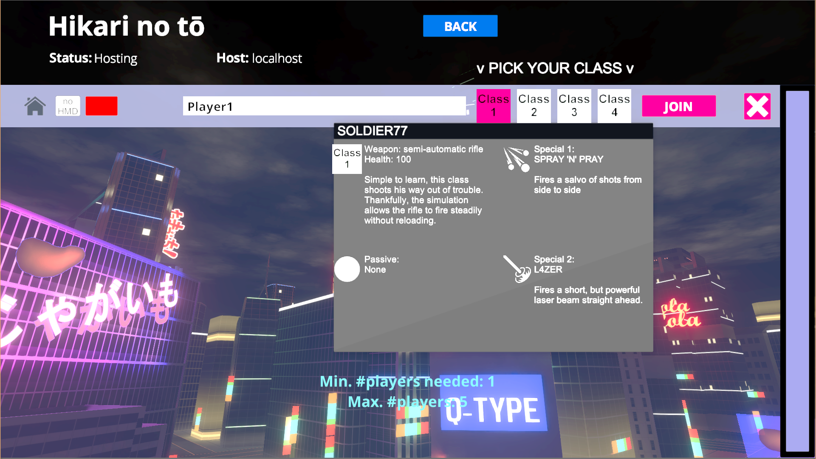
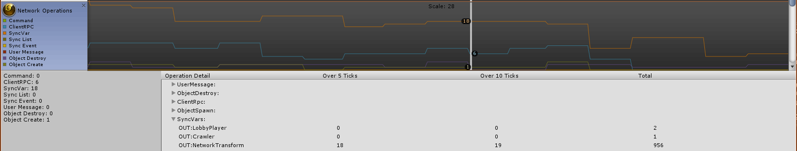
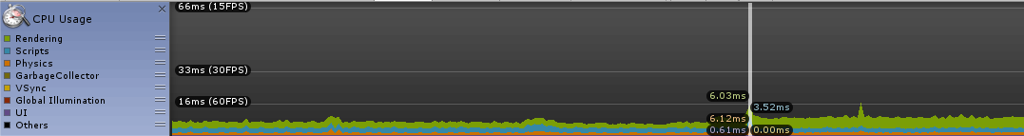
Visuals, UI, audio, profiling
Changes to:
Main menu, UI again
FX againSound effects (~50%)
Performance improved by up to 60%
Network profiling
Next steps: more UI indicators, lighting optimization, sfx

Slide 9
Game Balancing
Enemies made more deadly
Soldier
The “Long Distance Fighter”
Decreased overall damage
Infiltrator
The “Stealth Character”
Invisibility improved
Backstab damage reduced
Sumo
The “Tank”
Increased damage
Health increased
Berserker
The “Close Quarters Fighter”
Rage requirement reduced
Rage improved

Slide 10
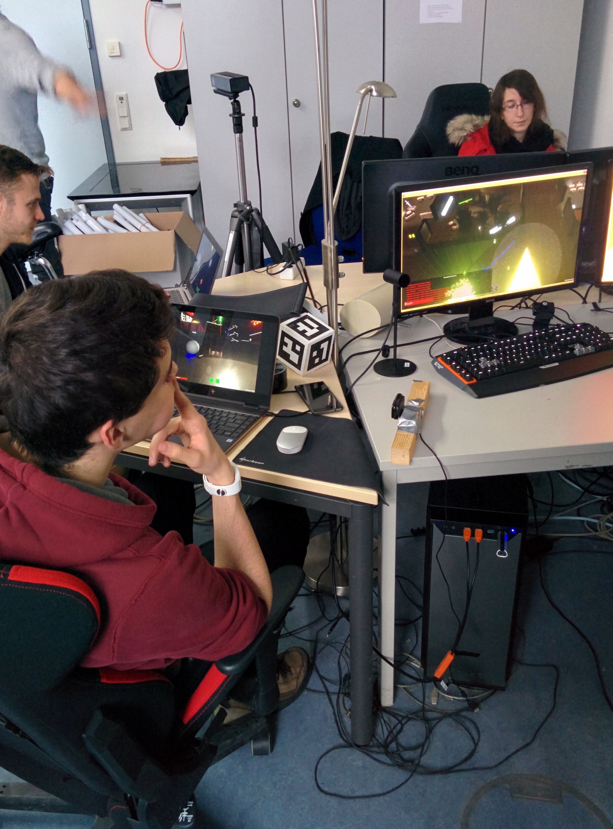
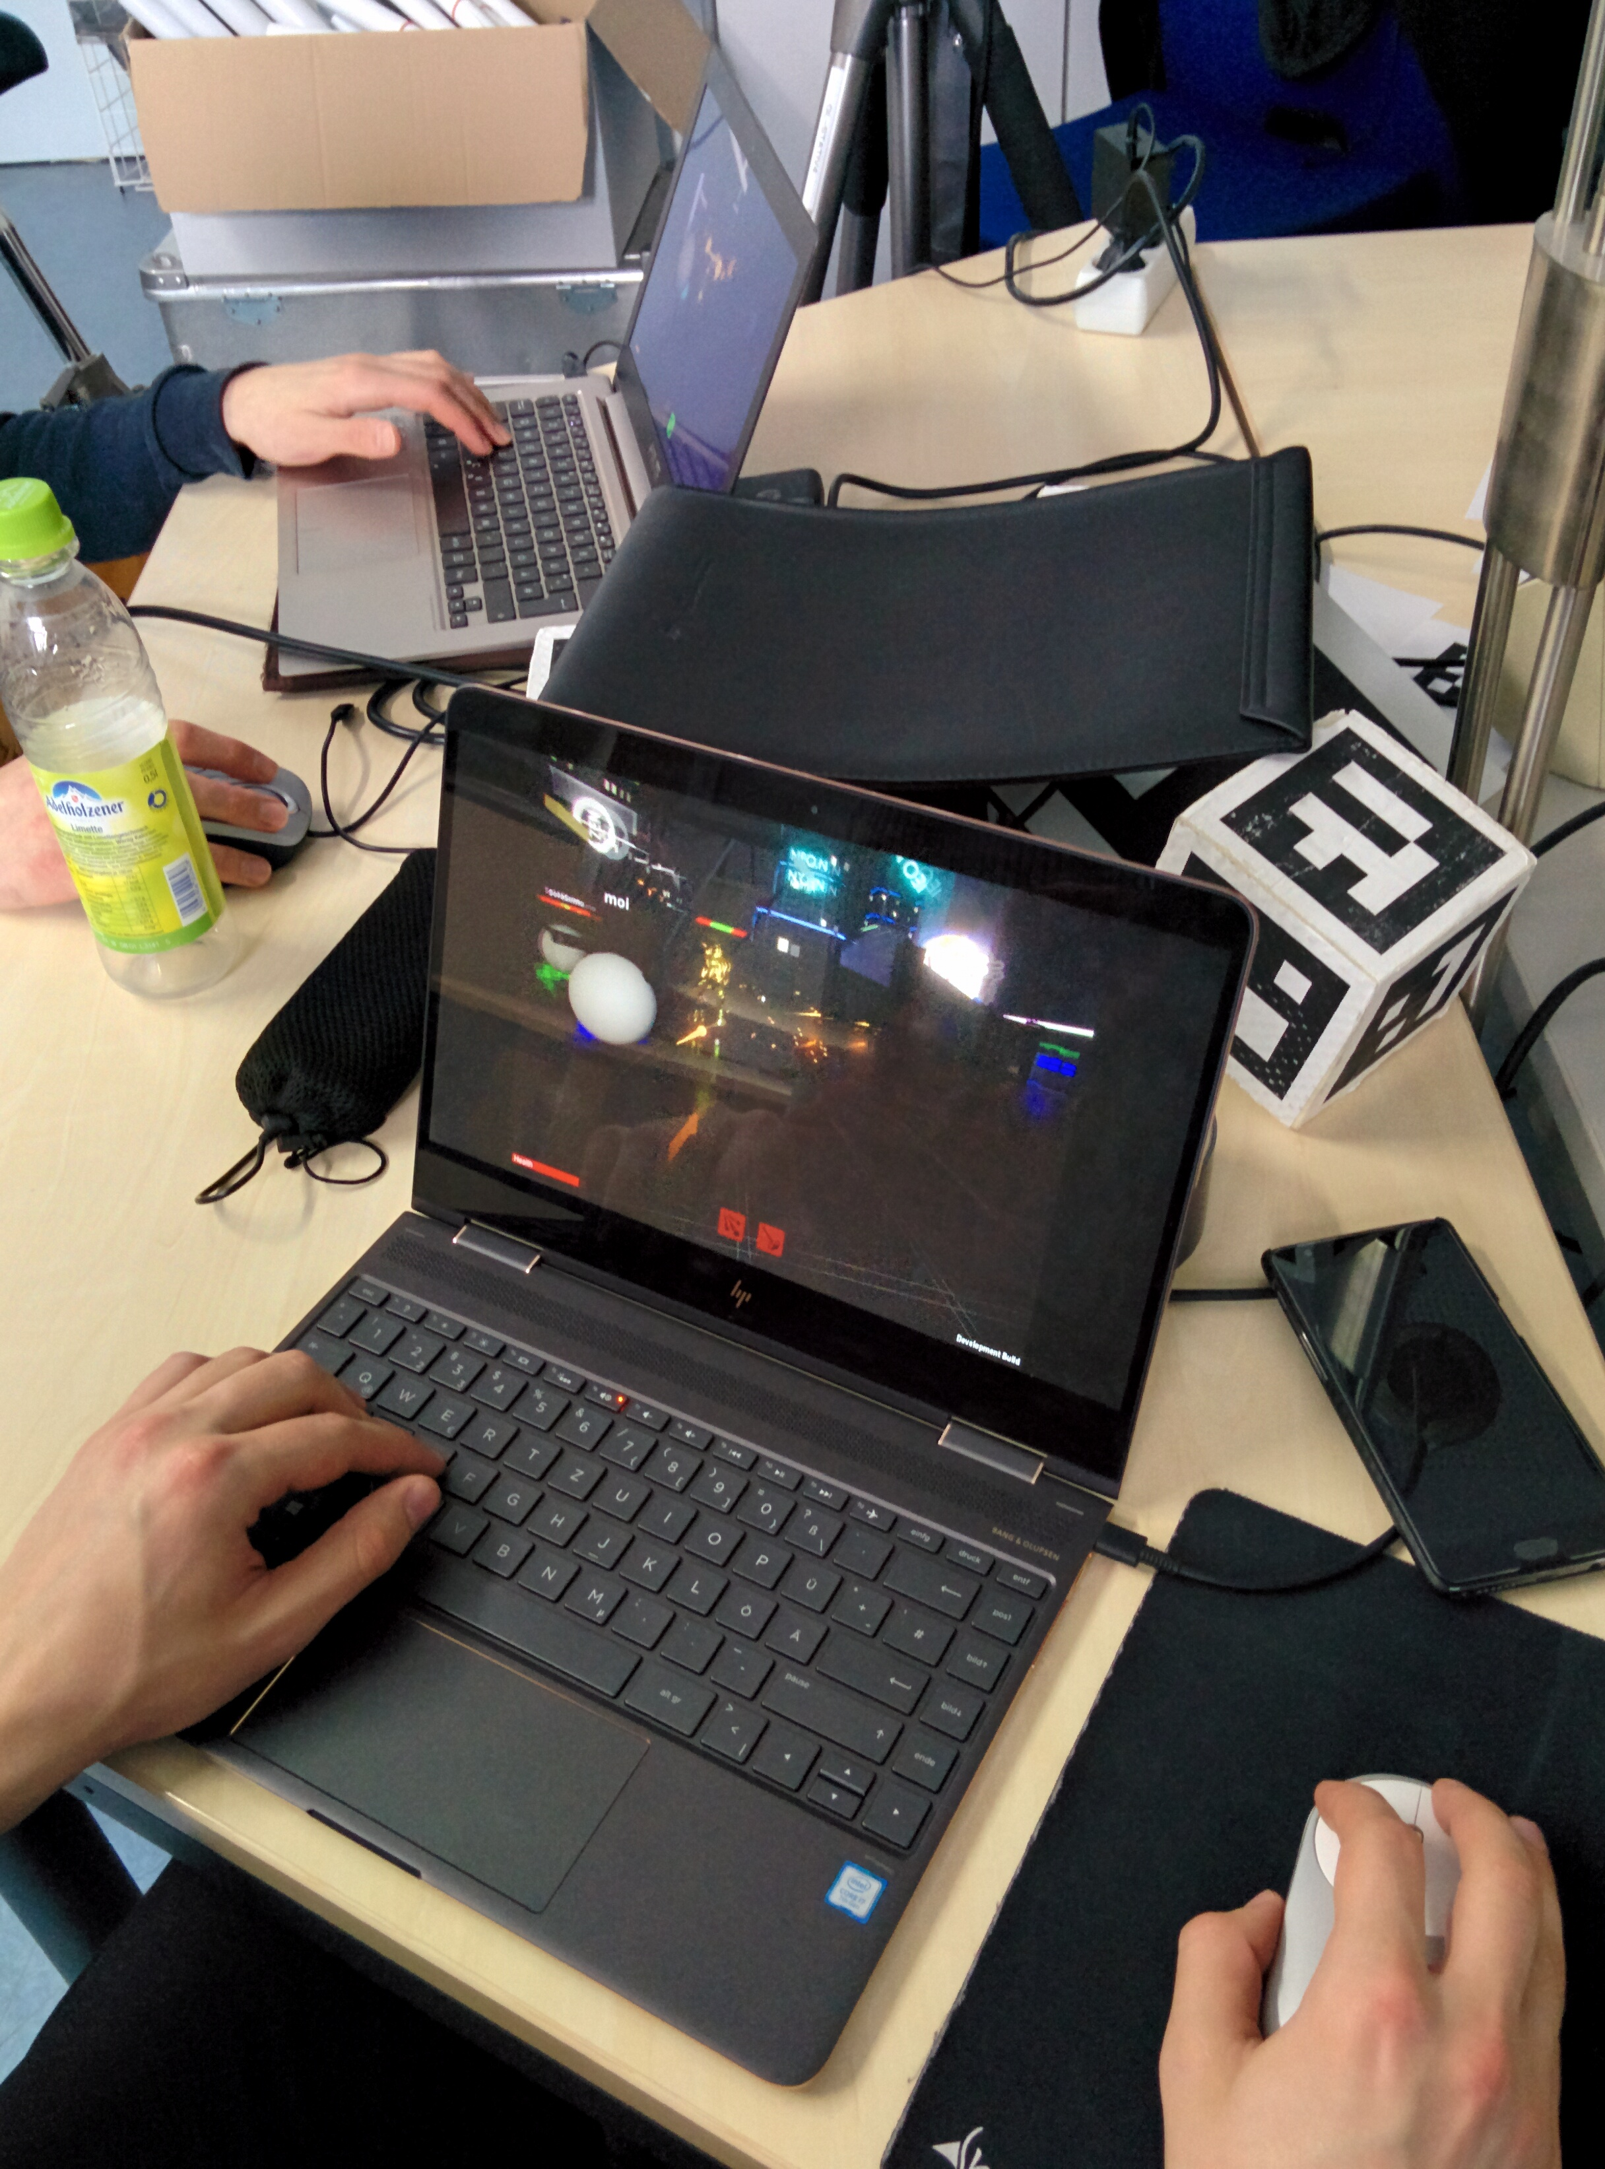
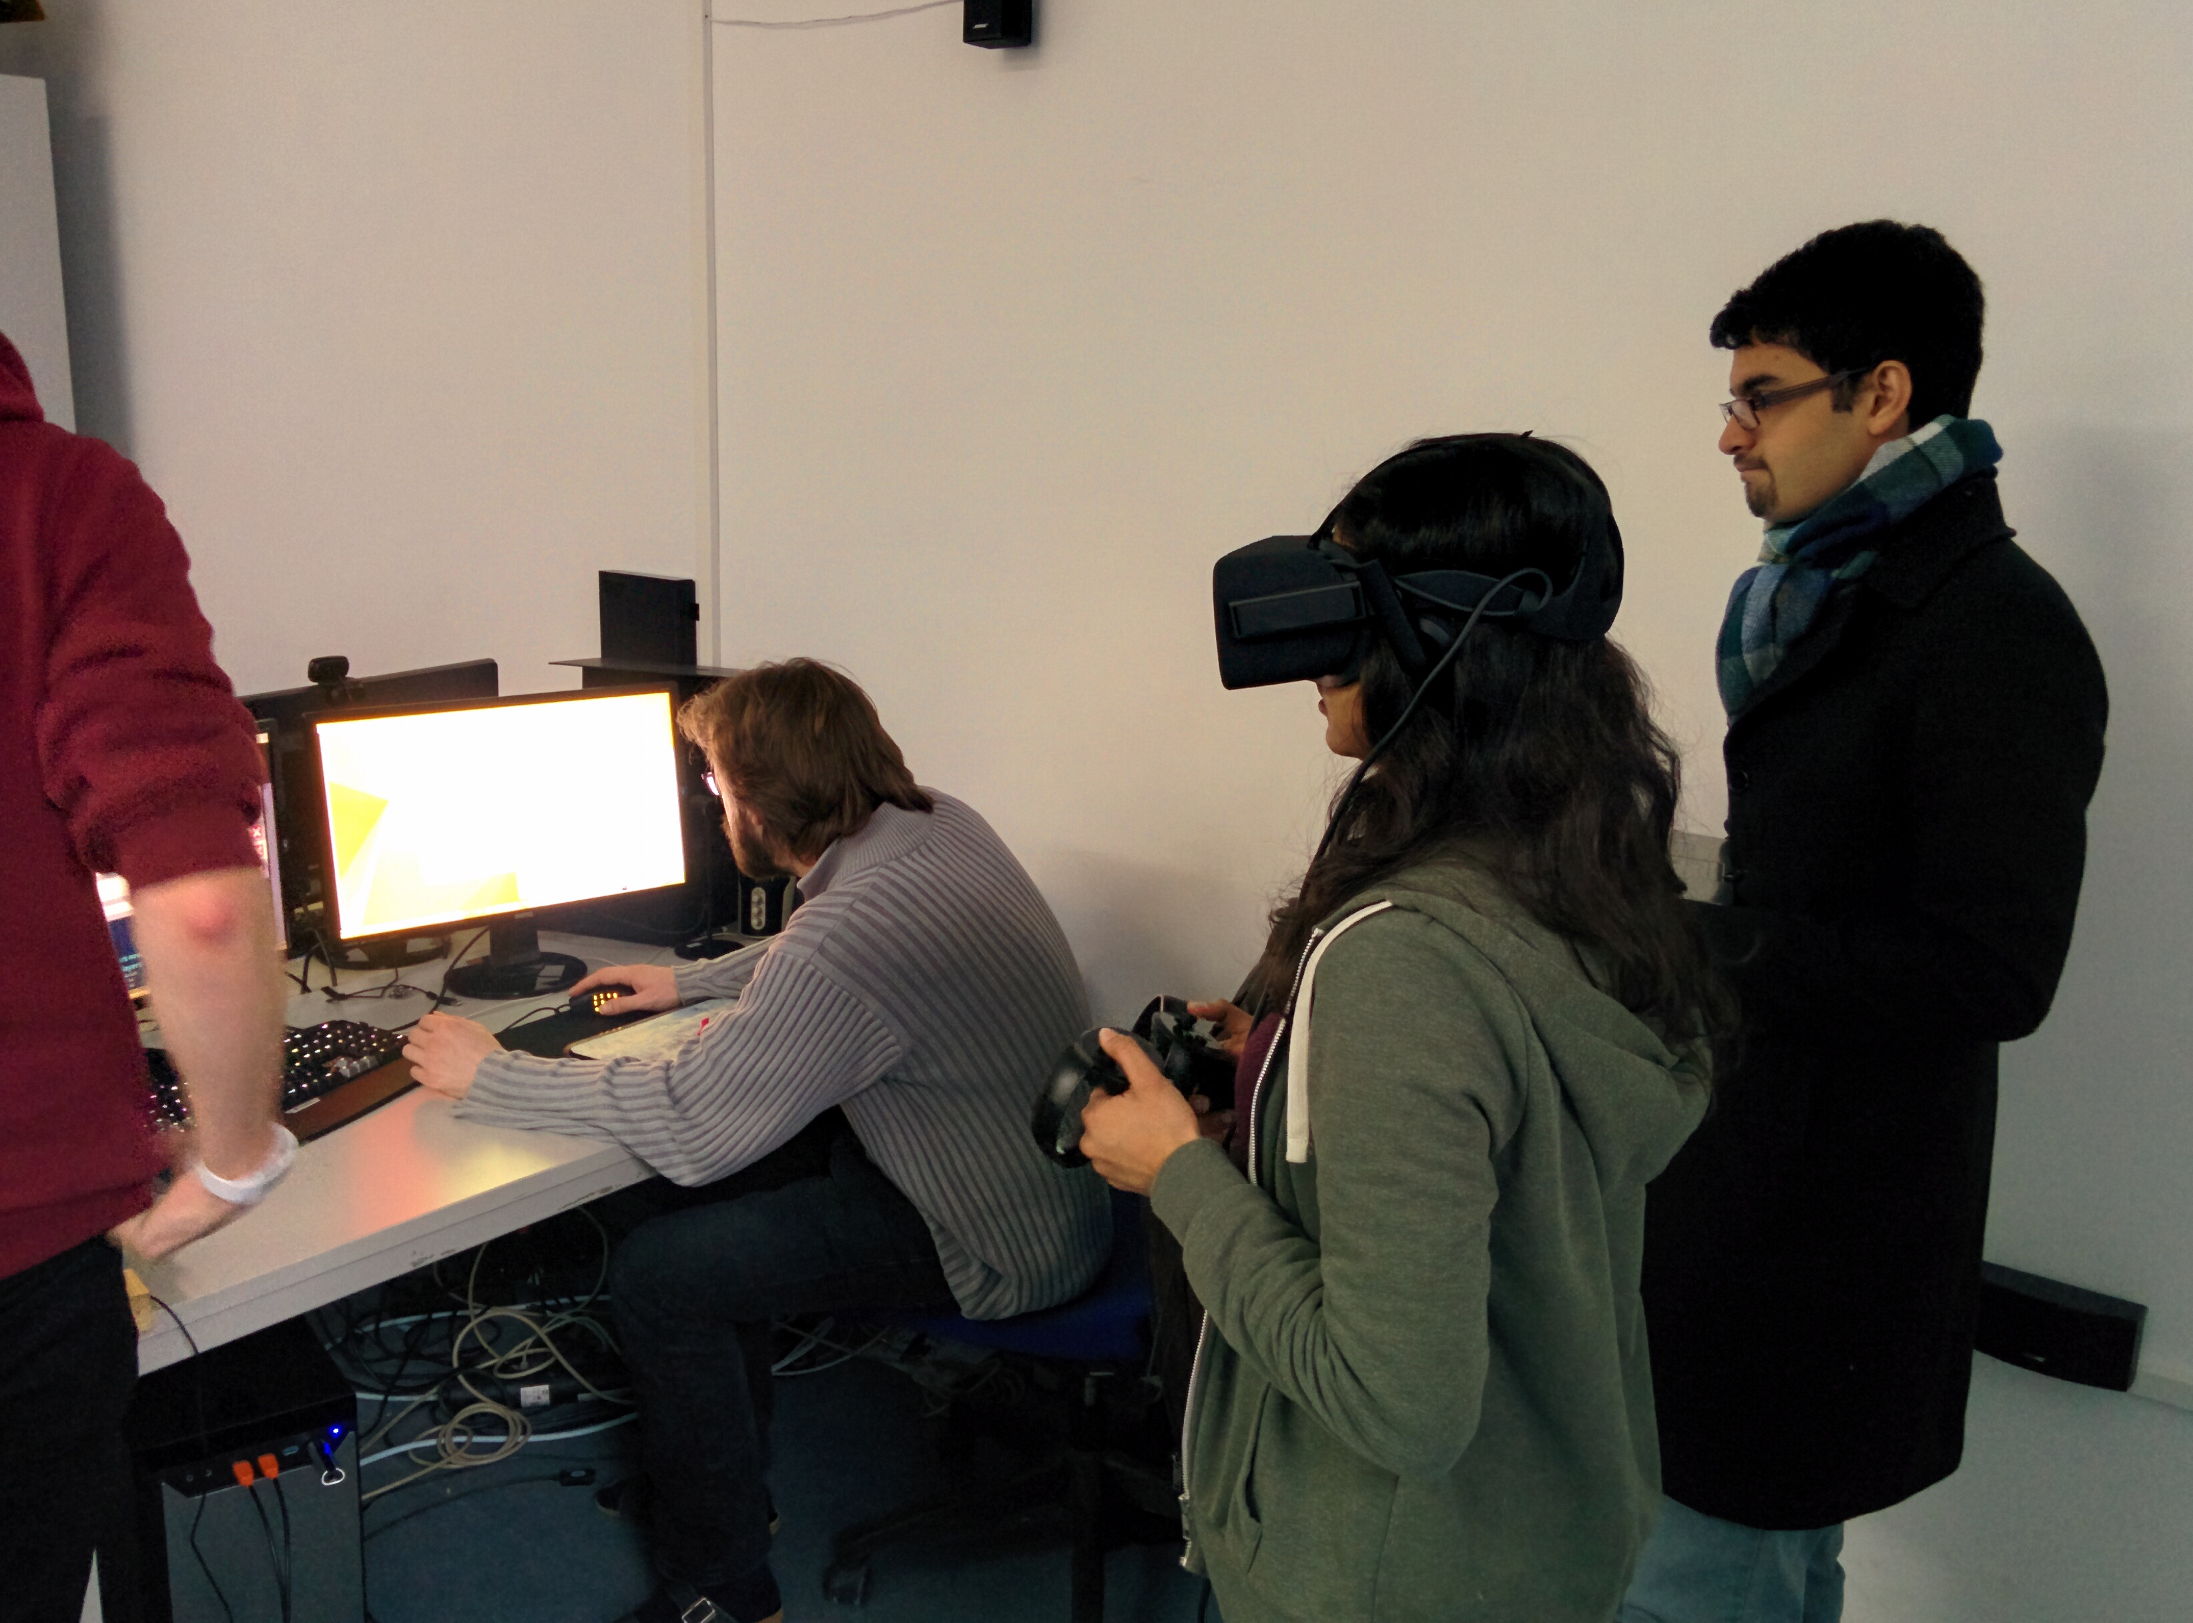
Master Playtest: The Playtesters
One gamer, one non-gamer
Both VR noob
Only brief introduction to VR and Rift in particular

Slide 11
Master Playtest: The Feedback
The good:
Throwing fireballs was fun
Saving allies gives a sense of purpose
Supporting kills with buffs and fireballs
Feeling of being a demi-god
The bad:
Master’s remaining ability pool not clear
Controls difficult for newcomers and time consuming to learn
Multiple play sessions required to get the master to a viable skill level

Slide 12
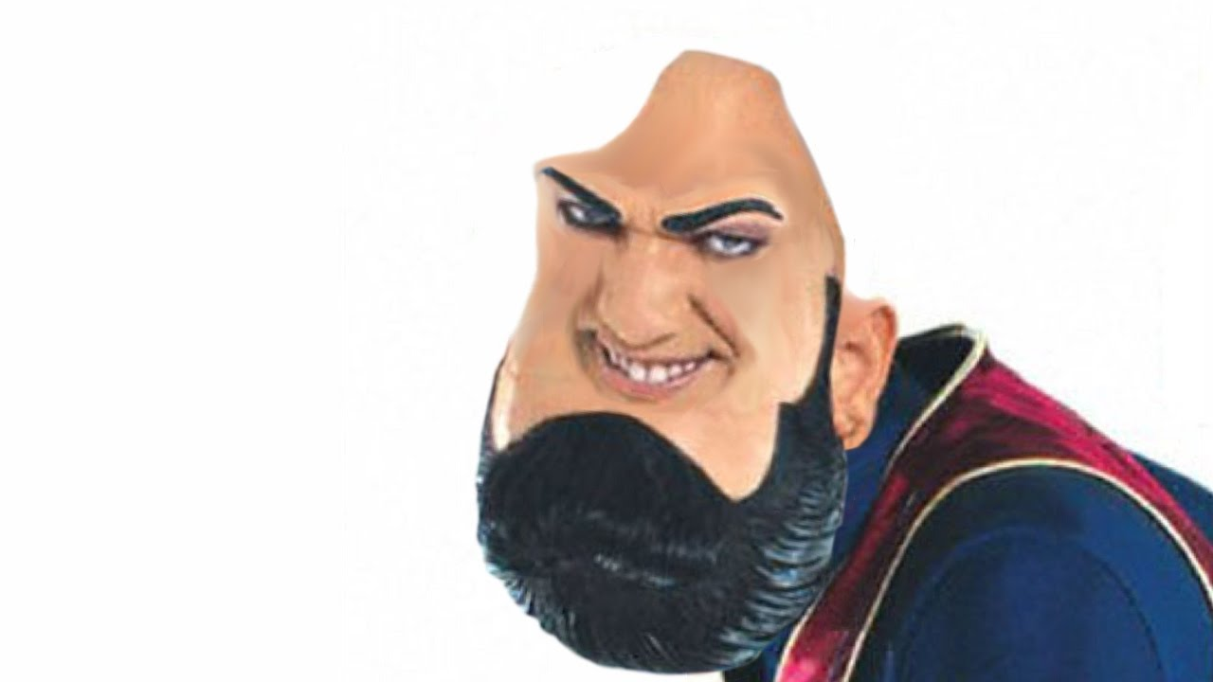
Questions?

